Slide 1
Project
Customer Retention

Slide 2
Problem Statement
According to the problem statement, there are five factors that influence the success of online e-store such as service quality, system quality, information quality, trust and net benefit. These five factors will lead to the Customer Retention.
We need to perform EDA on Customer Retention dataset.

Slide 3
Understanding of the Dataset
In this dataset, we have 71 independent and dependent variables. All the 70 independent variables will determine the y output.
Here, the y output is Which of the Indian online retailer would you recommend to a friend?
The target variable is of categorical data type, which contains different classes. So, this dataset is of classification problem.

Slide 4
EDA (Exploratory Data Analysis)
Various steps followed in EDA for the dataset Customer Retention such as:
Finding Missing Values and Treatment of Missing Values.
Seperating Numerical Variables and Making DataFrame of it.
Visualization of Numerical Variables.
Checking Relationship with Numerical Variables and Target Variable.
Detecting Outliers in Numerical Variables.
Seperation of Categorical Variables and Making DataFrame of it.
Visualization of Categorical Variables.
Checking Relationship between Categorical Variables and Target Variable.
Detecting Outliers in Categorical Variables.

Slide 5
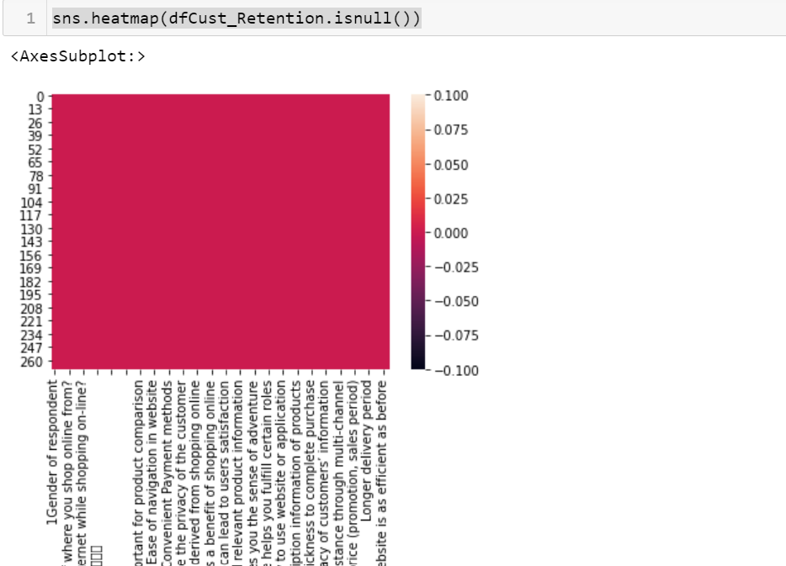
Detecting Missing Values
In this Customer Retention Dataset, we don’t have any missing values in all of 71 features. From the below heatmap, we can analyse that there is no nan values available.

Slide 6
Making DataFrame of Categorical Variables
In this dataset, we have around 24 independent variables and 1 dependent variable with a categorical data.

Slide 7
Visualization of Categorical Data
We have performed visualization of categorical variables using countplot as it provides frequency of the classes of each categorical columns.

Slide 8
Checking relationship b/w categorical and target variables.
Here, we have used bar graph to analyse the relationship between all the categorical variable and y output.

Slide 9
Detecting Outliers
Generally, outliers are not found in categorical features.

Slide 10
Making DataFrame of Numerical Variables
Here, we have 46 independent variables that contains numerical data.

Slide 11
Visualization of Numerical Variables
In this dataset, visualization of different numerical variables has been performed by using countplot.

Slide 12
Checking relationship b/w numerical variable and target variable
We have performed bar graph in order to check the relationship between each numerical variables and target variable.

Slide 13
Detecting Outliers in Numerical Variables
In this dataset, we don’t have any feature with continuous numerical data. Mostly the outliers can be seen in continuous variables.
As we have performed boxplot on numerical variables available in the dataset and we can analyse very few outliers in some of the variables.

